Slide 1

CAP444 OBJECT ORIENTED PROGRAMMING USING C++
FRIEND FUNCTION

Slide 2
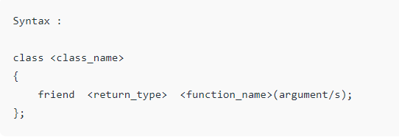
A friend function can be given a special grant to access private and protected members. A friend function can be:
a) A member of another class
b) A global function

Slide 3
Friend function
It can access all private and protected member of a class
It can be access without object of the class
It can define out side of the class scope
Rule:
Prototypes of friend function must be declare inside the class
It can be declared either in the private or the public part.

Slide 4
Syntax :
class <class_name>
{
friend <return_type> <function_name>(arguments);
};

Slide 5
Example : friend function
#include <iostream>
using namespace std;
class A
{
private:
int x;
public:
A()
{
x=10;
}
private:
friend void newfriend(A &a);
};
void newfriend(A &a)
{
a.x=20;
cout<<a.x;
}
int main()
{
A a1;
newfriend(a1);
return 0;
}

Slide 6
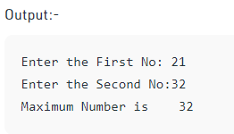
void find_max(Largest t)
{
if(t.a>t.b)
t.m=t.a;
else
t.m=t.b;
cout<<"Maximum Number is\t"<<t.m;
}
Int main()
{
Largest l;
l.set_data();
find_max(l);
return 0;
}
#include<iostream>
using namespace std;
class Largest
{
int a,b,m;
public:
void set_data();
friend void find_max(Largest);
};
void Largest::set_data()
{
cout<<"Enter the First No:";
cin>>a;
cout<<"Enter the Second No:";
cin>>b;
}

Slide 7
bridge between the classes
#include<iostream>
using namespace std;
class ABC;// forward declaration
class XYZ
{
int x;
public:
void set_data(int a)
{
x=a;
}
friend void max(XYZ,ABC);
};
class ABC
{
int y;
public:
void set_data(int a)
{
y=a;
}
friend void max(XYZ,ABC);
};
void max(XYZ t1,ABC t2)
{
if(t1.x>t2.y)
cout<<t1.x;
else
cout<<t2.y;
}
int main()
{
ABC _abc;
XYZ _xyz;
_xyz.set_data(20);
_abc.set_data(35);
max(_xyz,_abc); //callin friend function
return 0;
}

Slide 8
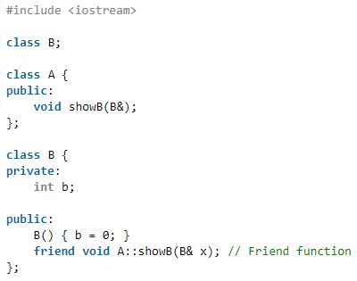
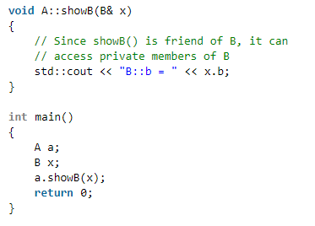

friend function of another class

Slide 9
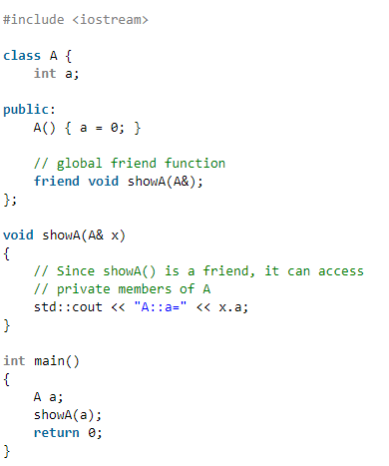
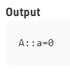
Demonstrate global friend

Slide 10
Characteristics
A friend function is a special function in C++ which in-spite of not being member function of a class has privilege to access private and protected data of a class.
A friend function is a non member function or ordinary function of a class, which is declared as a friend using the keyword “friend” inside the class. By declaring a function as a friend, all the access permissions are given to the function.
The keyword “friend” is placed only in the function declaration of the friend function and not in the function definition.
When friend function is called neither name of object nor dot operator is used. However it may accept the object as argument whose value it want to access.
Friend function can be declared in any section of the class i.e. public or private or protected.

Slide 11
Following are some important points about friend functions and classes: 1) Friends should be used only for limited purpose. too many functions or external classes are declared as friends of a class with protected or private data, it lessens the value of encapsulation of separate classes in object-oriented programming. 2) Friendship is not mutual. If class A is a friend of B, then B doesn’t become a friend of A automatically. 3) Friendship is not inherited 4) The concept of friends is not there in Java.

Slide 12
